Slide 1
Predicting Ames Housing Prices Machine Learning Project
EL GRUPO, AUGUST 2019
Notes:
Maite (intro)
1. Welcome to our presentation! We are Charlie, Mario, Julie and Maite, also known as “El Grupo”. 2. Let’s dig in!

Slide 2
Agenda
1
3
BACKGROUND
- OBJECTIVE OF PROJECT
- DATASET
- A LITTLE BIT ABOUT AMES, IOWA
PREDICTIVE MODELS USED
- RIDGE
- LASSO
- KAGGLE RESULTS
2
4
DATA EXPLORATION AND CLEANING
- MISSING VALUES, NEW VARIABLES
- SKEWNESS
- MULTICOLLENIARITY
CONCLUSION
- ADDITIONAL MODELS, FE, DIMENSIONS
- EXTERNAL DATA ISSUE
- SYNCING ACCOUNTS
Notes:
Maite (Agenda)
1. We will start giving you a little bit of background: what is the objective of this project, the dataset and an overlook on Ames, Iowa. 2. Afterwards, (Charlie/Mario) will walk you through the main challenges we faced in the data exploration and cleaning face. As you know, 80% of the work of a data analyst is usually getting the data clear/right to get to the right conclusions.
Some of the topics we will be touching upon are: Missing Values, the Creation of new variables, Skewness and Multicollinearity.
3. (Charlie/Mario) Once we have understood the process followed for the data exploration and cleaning, it’s time to jump into the predictive models that we used: Lasso, Ridge, XGox, comparing adv/dis between them, and in general, between linear and non-linear modelling.
4. We stacked the product, we tested it and we obtained some results – we will see how successful we turned!

Slide 3

Background/Dataset information
1
#Rankings (CNN Money 2010, The Economist)
20 continuous variables (numerical)
Related to various area dimensions
14 discrete variables (numerical)
Quantify the number of items occurring within the house
23 nominal variables (categorical)
Identify various types of dwellings, garages, materials, and environmental conditions
23 ordinal variables (categorical)
Rate various items within the property
Notes:
Maite (Background Information)
When we did some research about Ames, we were expecting a low-density, “middle of nowhere” town, but we found a vibrant town instead.
The Dataset was compiled for use in data science education, and it’s a modern an expanded alternative to the Boston Housing Market.

Slide 4
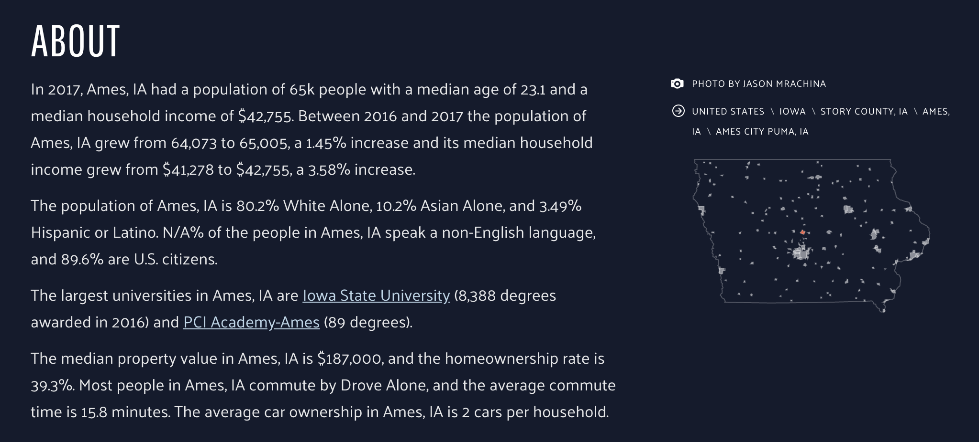
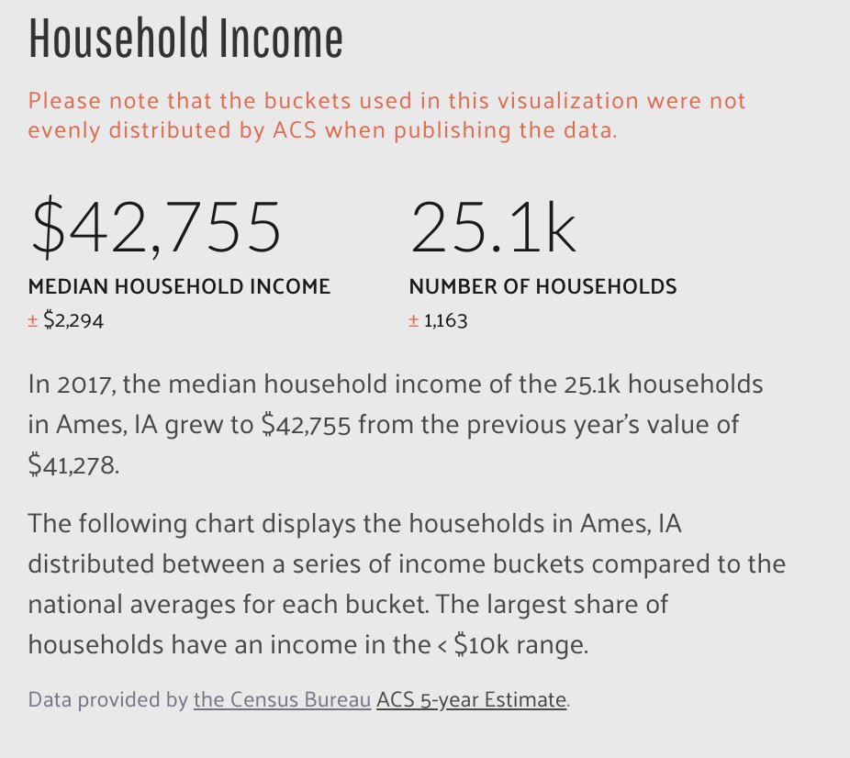
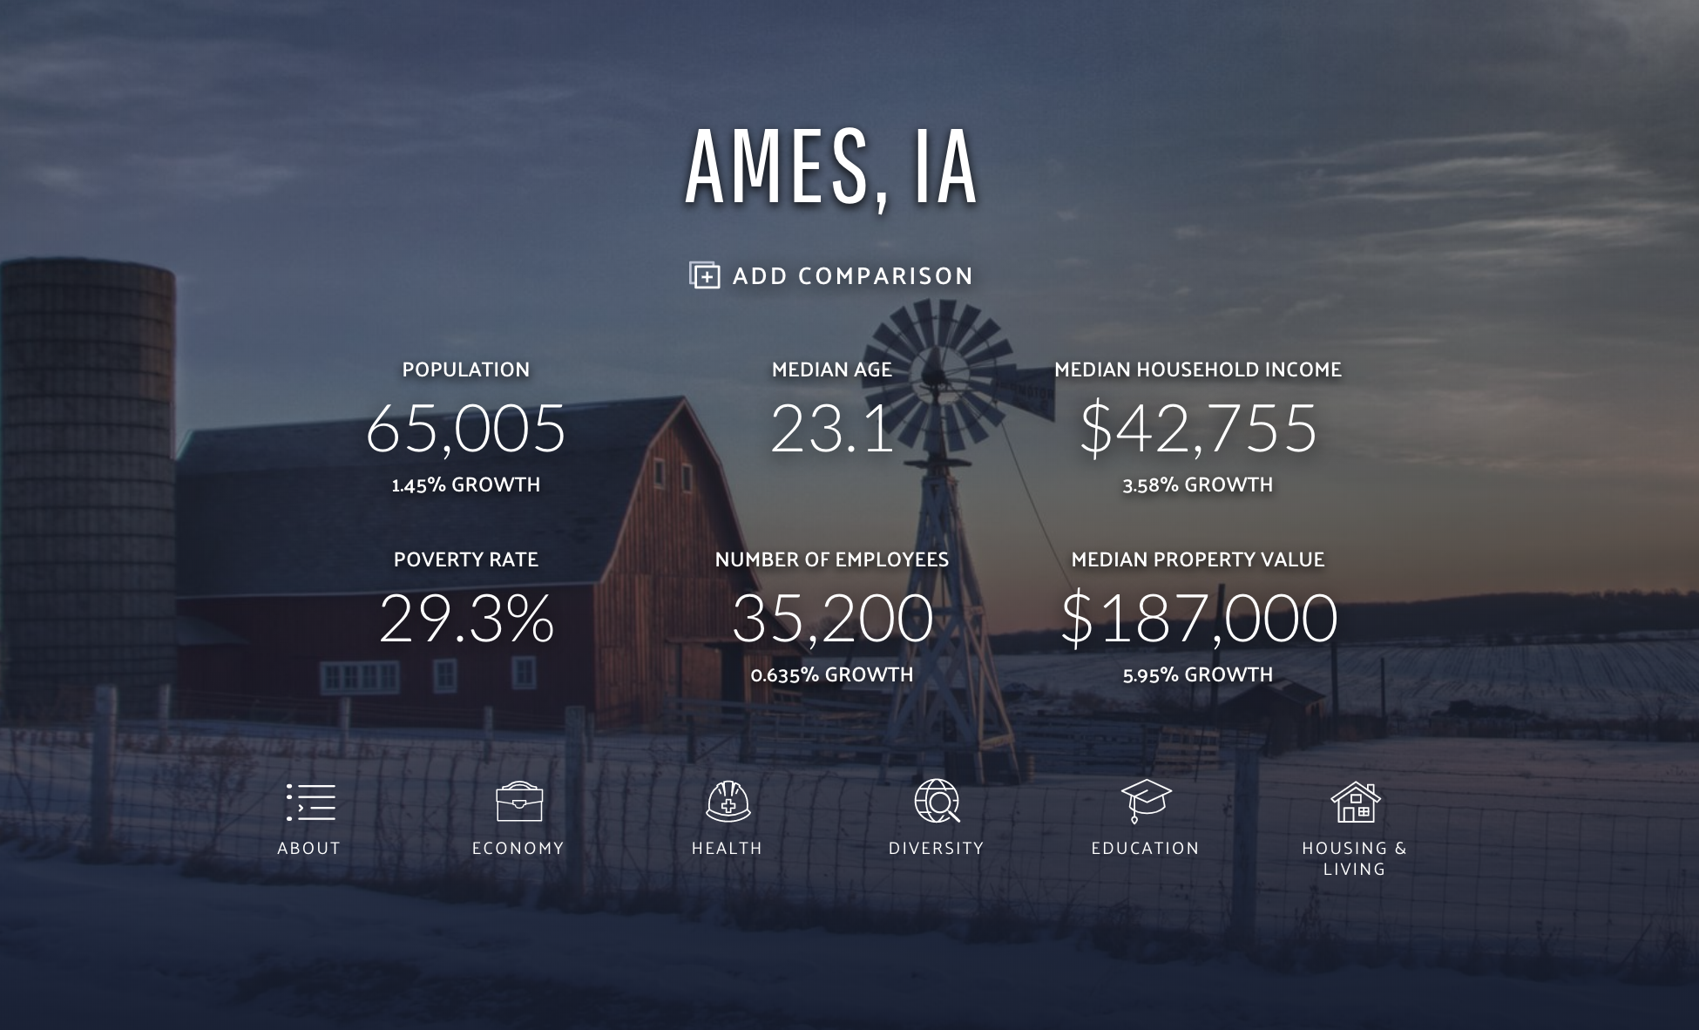
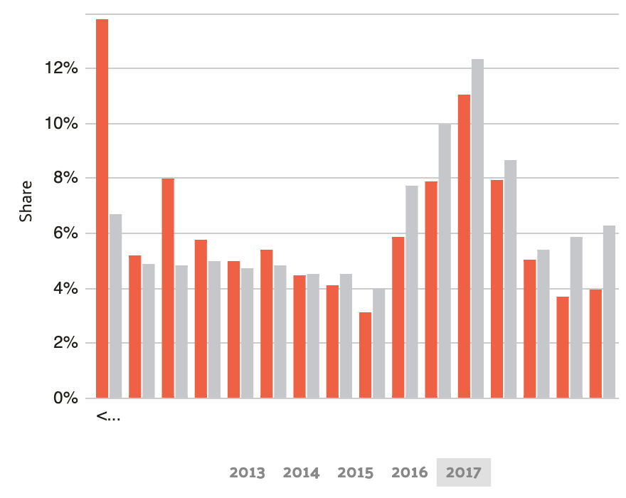
Background/Dataset information
1
Notes:
Maite (Background Information)
When we did some research about Ames, we were expecting a low-density, “middle of nowhere” town, but we found a vibrant town instead.
The Dataset was compiled for use in data science education, and it’s a modern an expanded alternative to the Boston Housing Market.

Slide 5
Agenda
1
3
BACKGROUND
- OBJECTIVE OF PROJECT
- DATASET
- A LITTLE BIT ABOUT AMES, IOWA
PREDICTIVE MODELS USED
- RIDGE
- LASSO
- KAGGLE RESULTS
2
4
DATA EXPLORATION AND CLEANING
- MISSING VALUES, NEW VARIABLES
- SKEWNESS
- MULTICOLLENIARITY
CONCLUSION
- ADDITIONAL MODELS, FE, DIMENSIONS
- EXTERNAL DATA ISSUE
- SYNCING ACCOUNTS
Notes:
Maite (Agenda)
1. We will start giving you a little bit of background: what is the objective of this project, the dataset and an overlook on Ames, Iowa. 2. Afterwards, (Charlie/Mario) will walk you through the main challenges we faced in the data exploration and cleaning face. As you know, 80% of the work of a data analyst is usually getting the data clear/right to get to the right conclusions.
Some of the topics we will be touching upon are: Missing Values, the Creation of new variables, Skewness and Multicollinearity.
3. (Charlie/Mario) Once we have understood the process followed for the data exploration and cleaning, it’s time to jump into the predictive models that we used: Lasso, Ridge, XGox, comparing adv/dis between them, and in general, between linear and non-linear modelling.
4. We stacked the product, we tested it and we obtained some results – we will see how successful we turned!

Slide 6
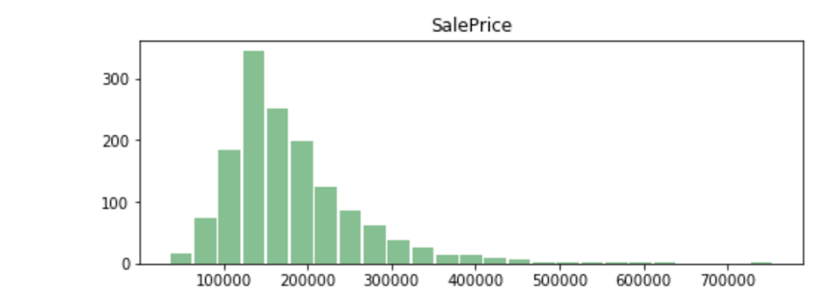
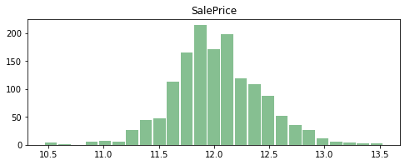
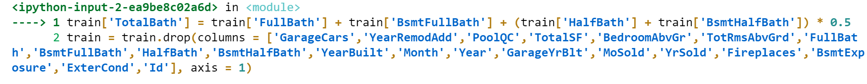
Data Exploration and Cleaning (1)
2
“SalePrice” is skewed right
np.log(df[‘SalePrice’])_
Dropping variables
Missing values
Feature Importance
New Variables Created
Notes:
Charlie/Mario (Data Exploration and Cleaning)

Slide 7
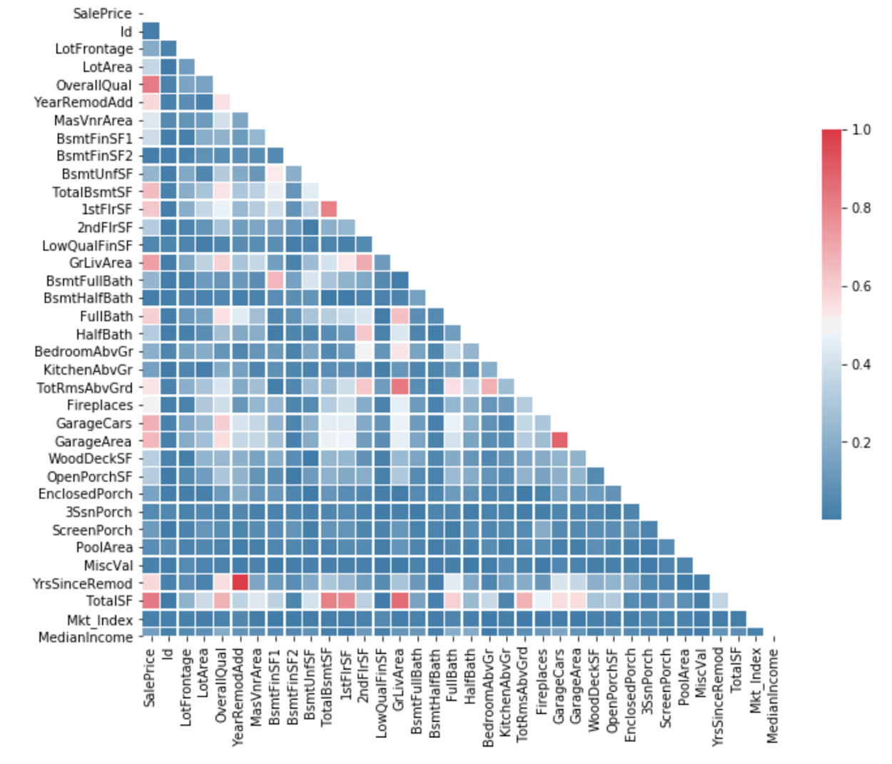
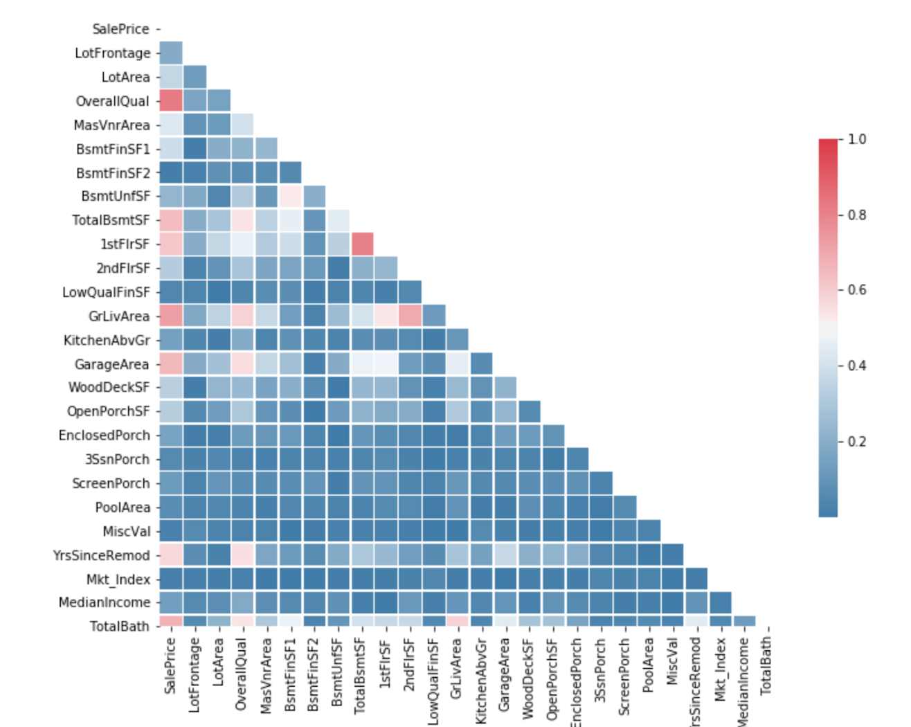
Data Exploration and Cleaning (2)
2
Multicollinearity (1) Before
Multicollinearity (2) After
Notes:
Charlie/Mario (Data Exploration and Cleaning)
Process of dropping (name granularity, and the reference value used)
e.g. livable space > number of rooms.

Slide 8
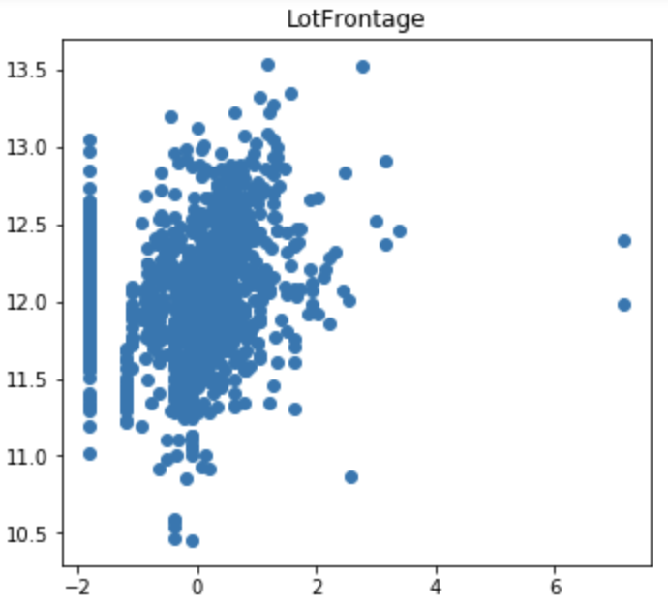
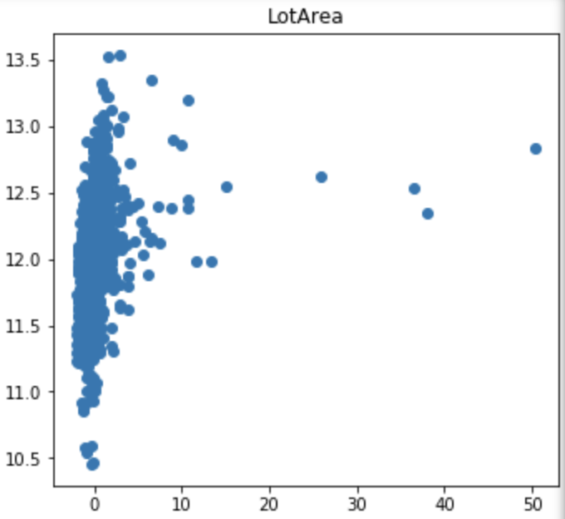
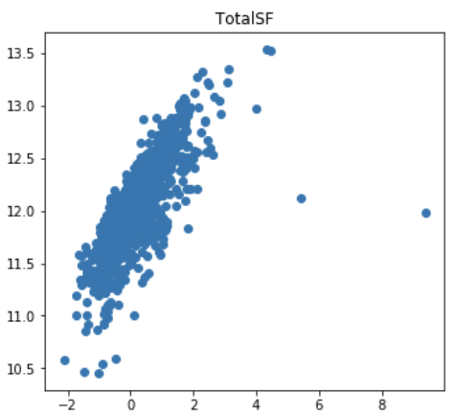
2
Data Exploration and Cleaning (3)

Slide 9
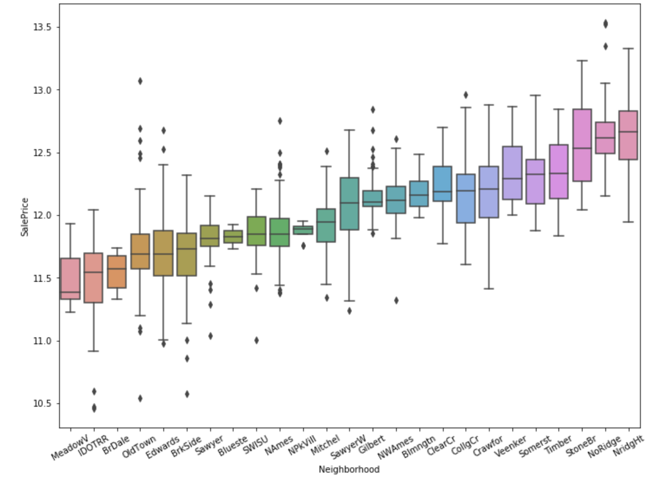
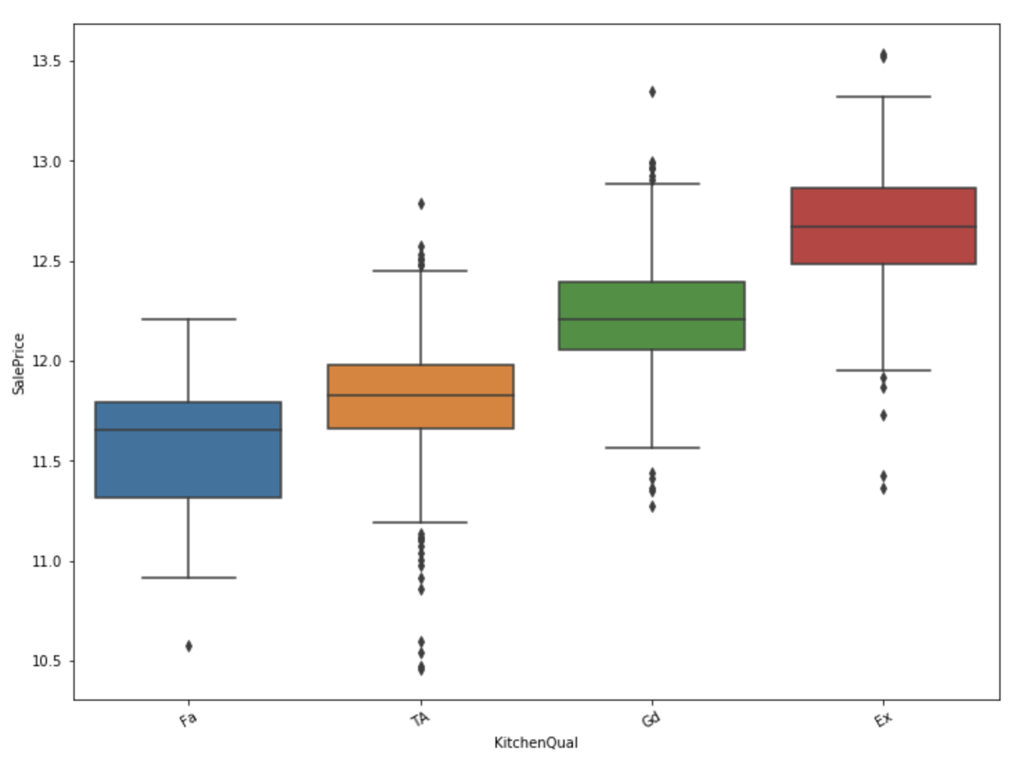
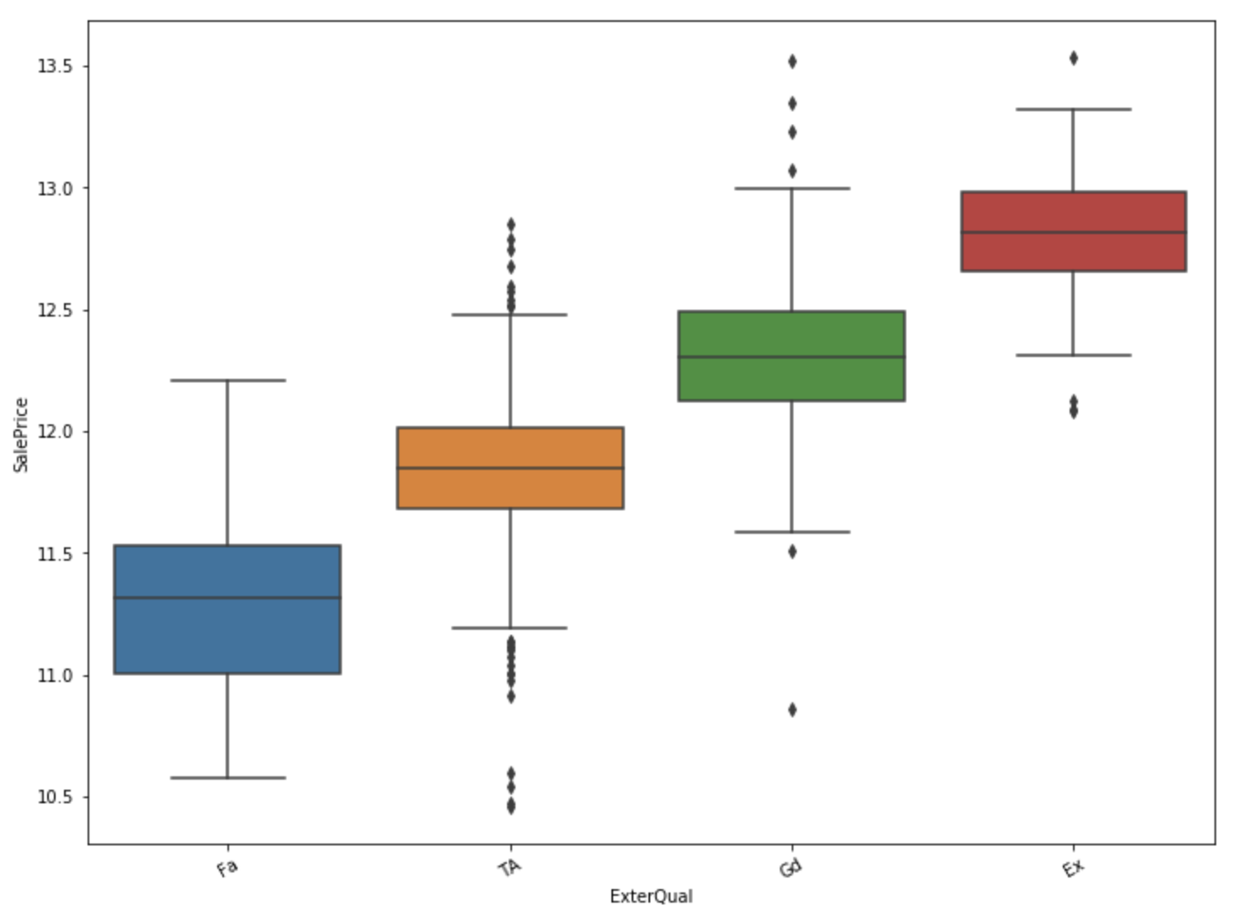
Data Exploration and Cleaning (4)
2
Neighborhood
Kitchen Quality
Exterior Quality
Notes:
Charlie/Mario (Data Exploration and Cleaning)
Let’s check with Mario.

Slide 10
Agenda
1
3
BACKGROUND
- OBJECTIVE OF PROJECT
- DATASET
- A LITTLE BIT ABOUT AMES, IOWA
PREDICTIVE MODELS USED
- RIDGE
- LASSO
- KAGGLE RESULTS
2
4
DATA EXPLORATION AND CLEANING
- MISSING VALUES, NEW VARIABLES
- SKEWNESS
- MULTICOLLENIARITY
CONCLUSION
- ADDITIONAL MODELS, FE, DIMENSIONS
- EXTERNAL DATA ISSUE
- SYNCING ACCOUNTS
Notes:
Maite (Agenda)
1. We will start giving you a little bit of background: what is the objective of this project, the dataset and an overlook on Ames, Iowa. 2. Afterwards, (Charlie/Mario) will walk you through the main challenges we faced in the data exploration and cleaning face. As you know, 80% of the work of a data analyst is usually getting the data clear/right to get to the right conclusions.
Some of the topics we will be touching upon are: Missing Values, the Creation of new variables, Skewness and Multicollinearity.
3. (Charlie/Mario) Once we have understood the process followed for the data exploration and cleaning, it’s time to jump into the predictive models that we used: Lasso, Ridge, XGox, comparing adv/dis between them, and in general, between linear and non-linear modelling.
4. We stacked the product, we tested it and we obtained some results – we will see how successful we turned!

Slide 11
Predictive Models (1)
3
Model | Mean CV | RMSE
Lasso (Grid Search) | 0.945 | 0.009
Lasso CV | 0.898 | 0.016
Ridge | 0.945 | 0.009
Ridge CV | 0.938 | 0.01
Number of Variables: 243
Notes:
Charlie/Mario (Predictive Models)

Slide 12
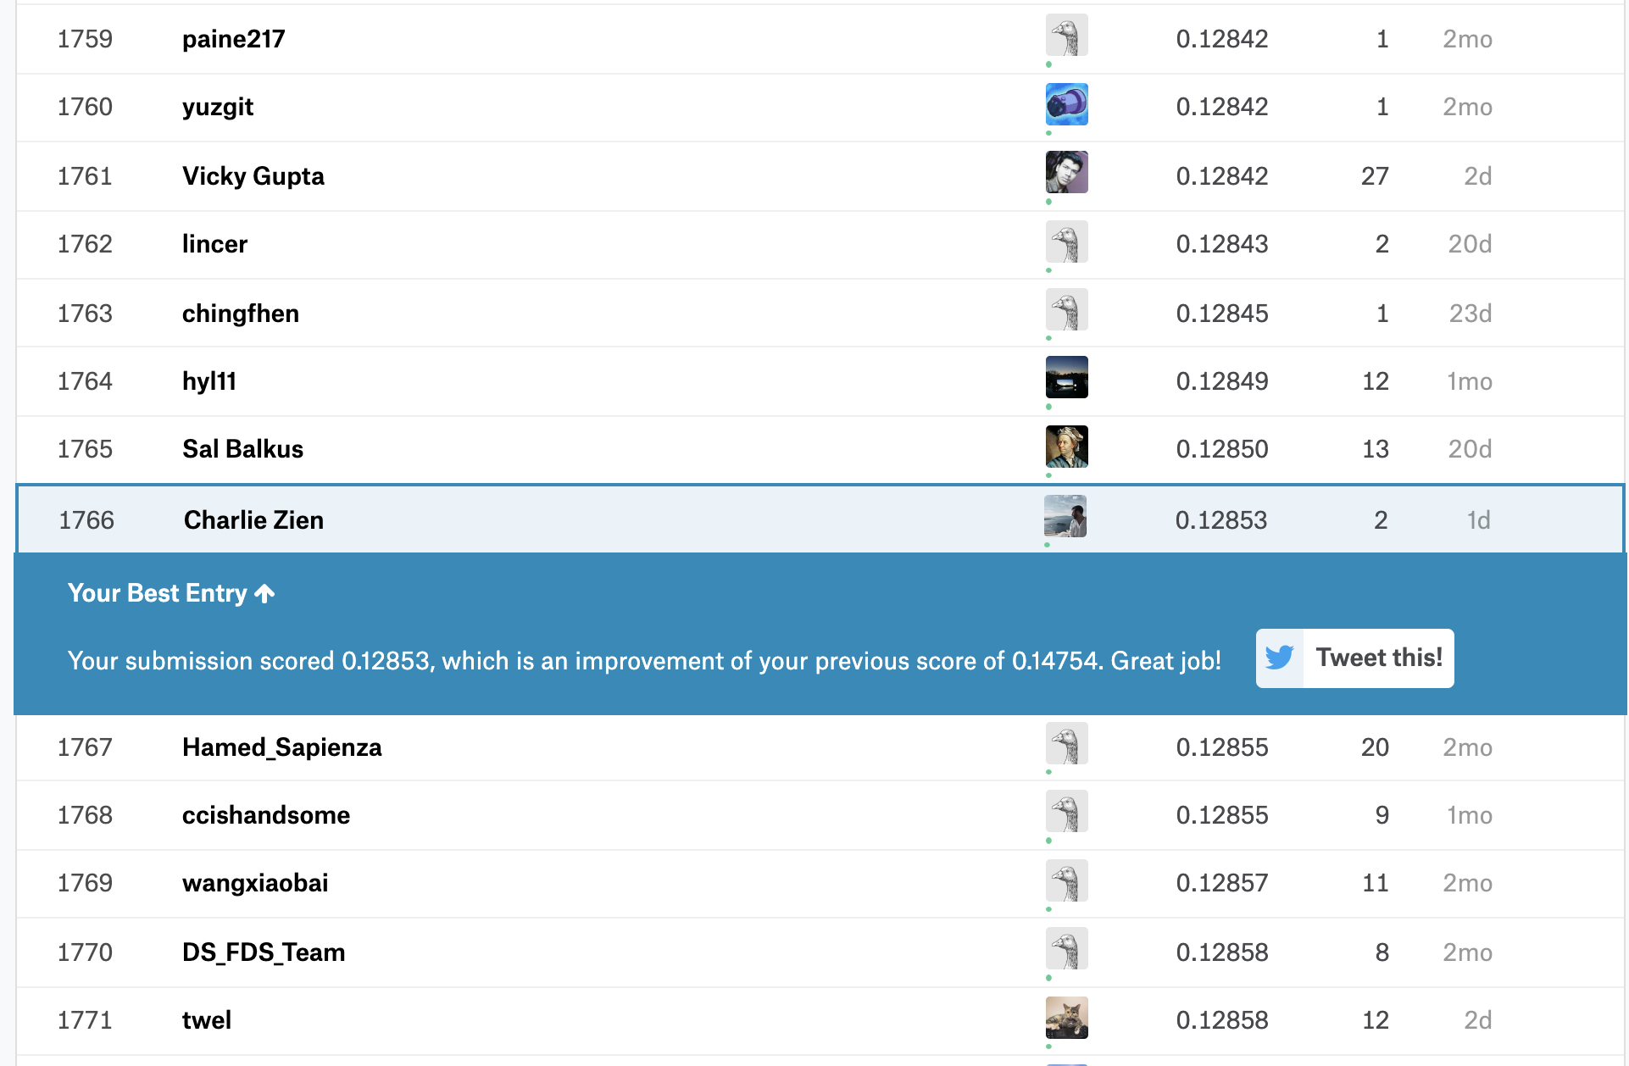
Predictive Models (2) Kaggle Results
4

Slide 13
Agenda
1
3
BACKGROUND
- OBJECTIVE OF PROJECT
- DATASET
- A LITTLE BIT ABOUT AMES, IOWA
PREDICTIVE MODELS USED
- RIDGE
- LASSO
- KAGGLE RESULTS
2
4
DATA EXPLORATION AND CLEANING
- MISSING VALUES, NEW VARIABLES
- SKEWNESS
- MULTICOLLENIARITY
CONCLUSION
- ADDITIONAL MODELS, FE, DIMENSIONS
- EXTERNAL DATA ISSUE
- SYNCING ACCOUNTS
Notes:
Maite (Agenda)
1. We will start giving you a little bit of background: what is the objective of this project, the dataset and an overlook on Ames, Iowa. 2. Afterwards, (Charlie/Mario) will walk you through the main challenges we faced in the data exploration and cleaning face. As you know, 80% of the work of a data analyst is usually getting the data clear/right to get to the right conclusions.
Some of the topics we will be touching upon are: Missing Values, the Creation of new variables, Skewness and Multicollinearity.
3. (Charlie/Mario) Once we have understood the process followed for the data exploration and cleaning, it’s time to jump into the predictive models that we used: Lasso, Ridge, XGox, comparing adv/dis between them, and in general, between linear and non-linear modelling.
4. We stacked the product, we tested it and we obtained some results – we will see how successful we turned!

Slide 14
Conclusion
4
To be improved:
Explore additional models (e.g. Random Forest, XG Boost)
Further feature engineering
Reduce Dimensions
Things that didn’t work:
Similar to other groups we brought additional external data without fruition
Troubles with github collaboration and .pynb syncing
Notes:
Julie (Conclusion) ¿¿¿¿===
Attempts / Non-attempts
Income Data
Housing Market Data

